Slide 1
Chapter XII
Screen-space Object Manipulation
All class materials including this PowerPoint file are available at
https://github.com/medialab-ku/openGLESbook

Slide 2
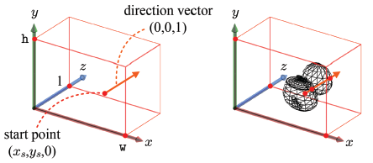
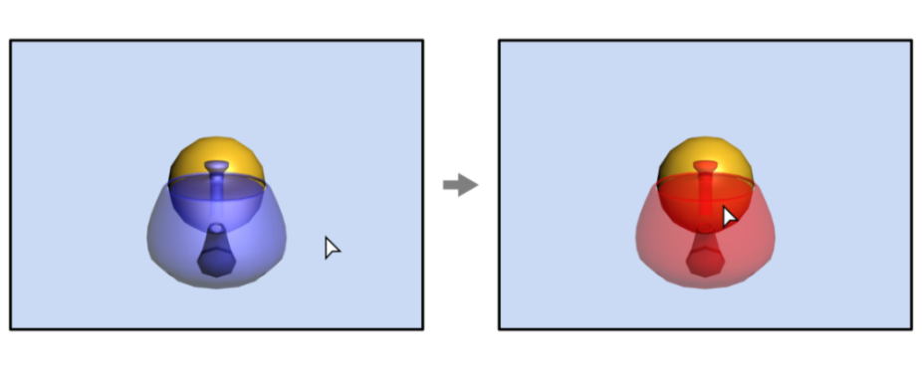
Object Picking
On touchscreen, an object can be picked by tapping it with a finger. In PC screen, mouse clicking is popularly used for the same purpose. Both simply return the 2D pixel coordinates (x_{s},y_{s}).
Given (x_{s},y_{s}), we can consider a ray described by the start point (x_{s},y_{s},0) and the direction vector (0,0,1).
We need ray-object intersection tests to find the object first hit by the ray, which is the teapot in the example. However, it is not good to compute the intersections in the screen space because the screen-space information available to us is not about the objects.
Our solution is to transform the screen-space ray back to the object spaces and do the intersection tests in the object spaces.
12-<number>

Slide 3
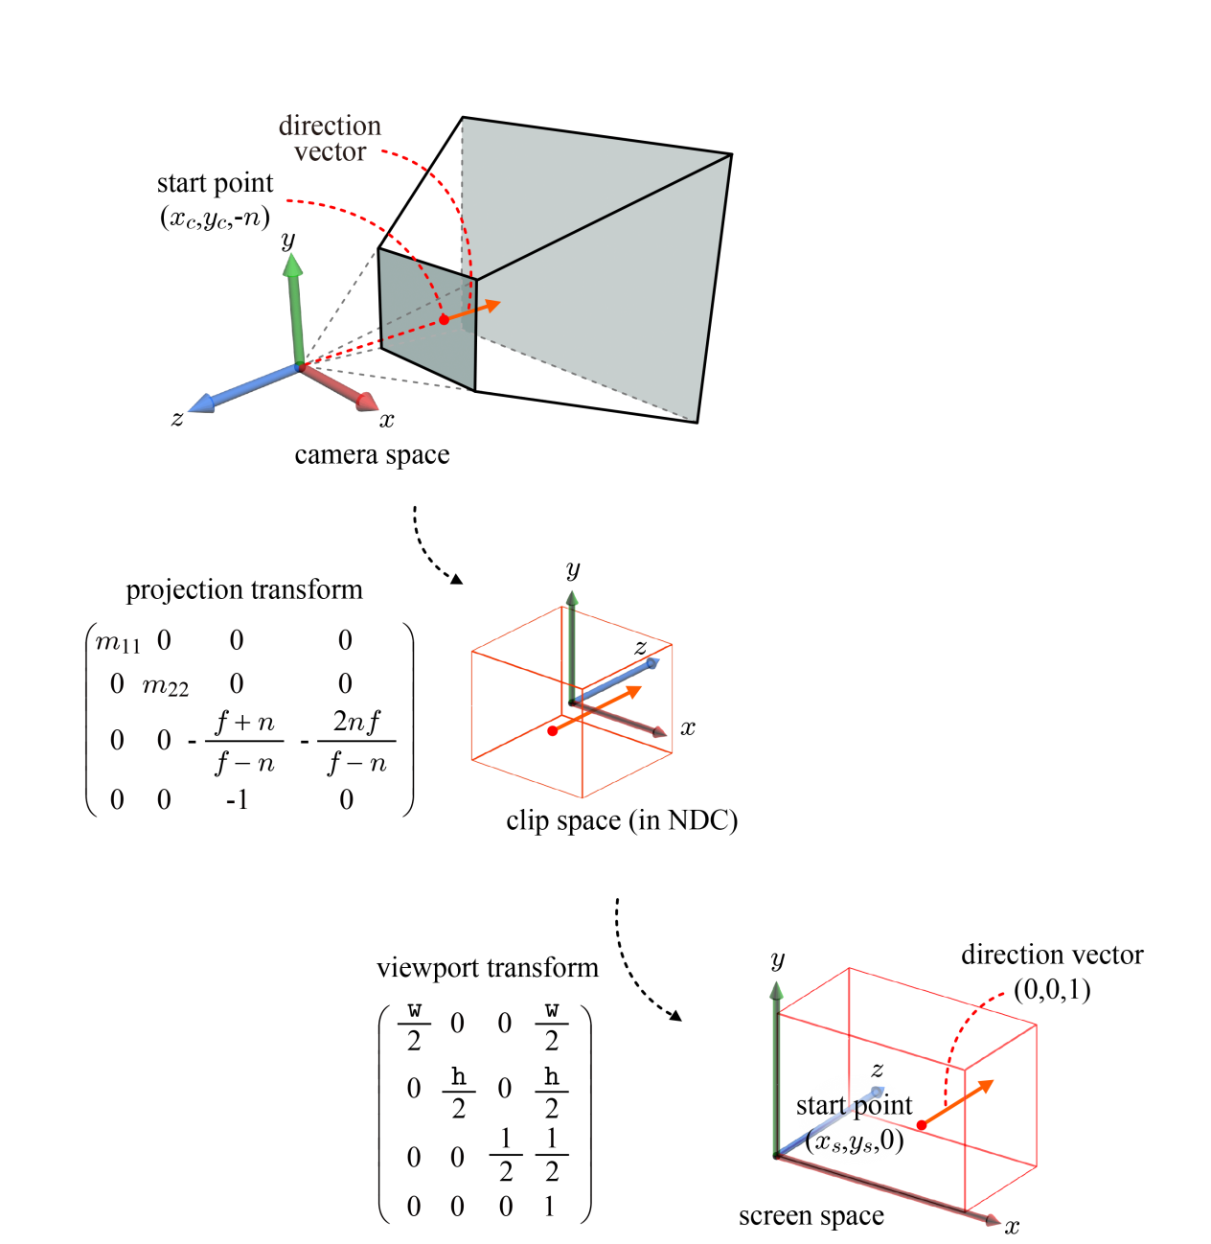
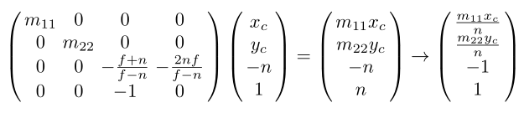





Camera-space Ray
direction vector of
the camera-space ray
12-<number>

Slide 4
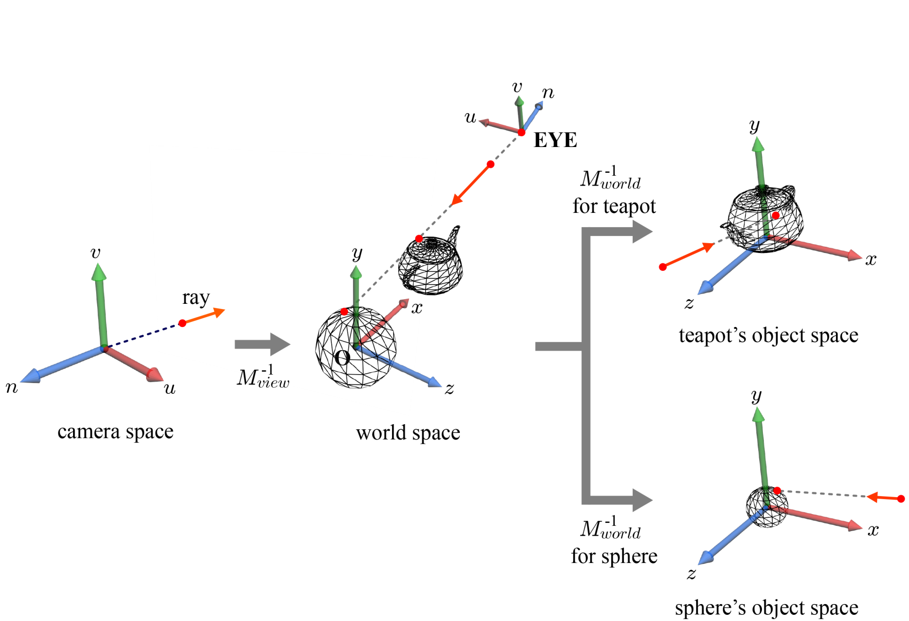
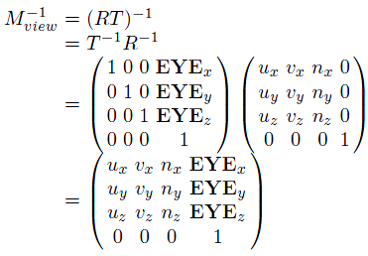
Object-space Ray
It is straightforward to transform the camera-space ray into the world space and then to the object space.
The teapot and sphere have their own world transforms.
Their inverses are applied to the world-space ray.
12-<number>

Slide 5
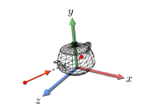
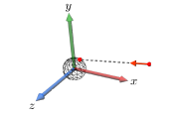
Ray Intersection
In order to determine if a ray hits an object represented in a polygon mesh, we have to perform a ray-triangle intersection test for every triangle of the object. If there exists at least a triangle intersecting the ray, the object is judged to be hit by the ray.
Unfortunately, processing every triangle would be costly. A faster but less accurate method is to approximate a polygon mesh with a bounding volume (BV).
12-<number>

Slide 6
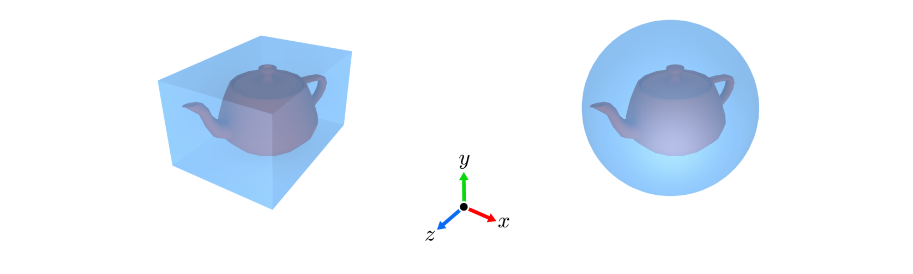
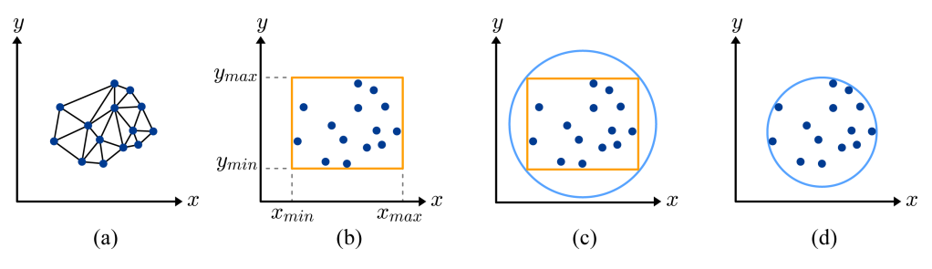
Bounding Volumes
Bounding volumes: axis-aligned bounding box and bounding sphere
Bounding volume creation
12-<number>

Slide 7
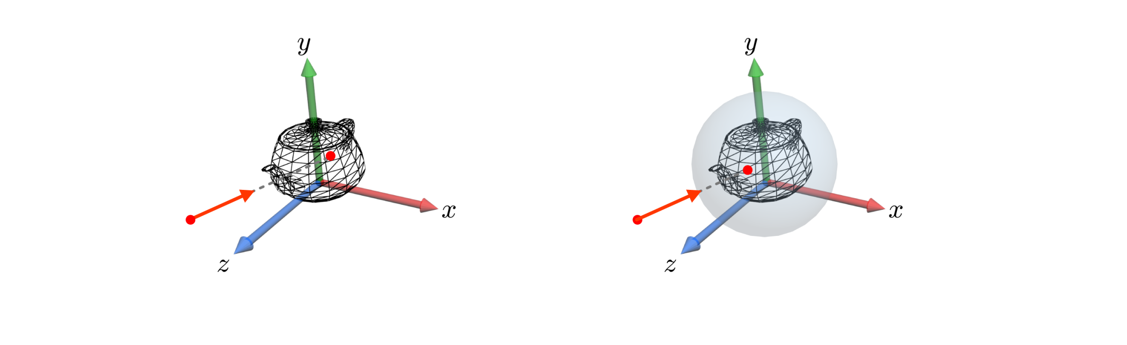
Ray-BV Intersection
Intersection tests with polygon meshes vs. bounding volumes.
12-<number>

Slide 8


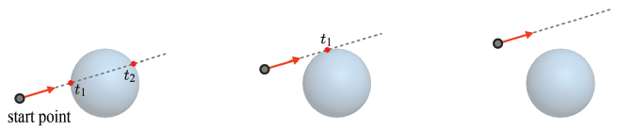
Ray-BV Intersection (cont’d)
For the ray-sphere intersection test, let us represent the ray in three parametric equations.
Insert x(t), y(t), and z(t) into the bounding sphere equation.
Three cases determined by the discriminant.
Given two distinct roots, choose the smaller.
12-<number>

Slide 9
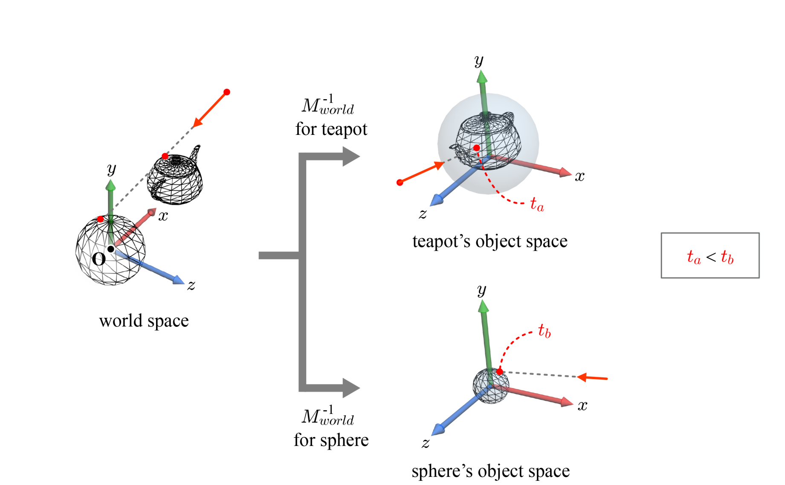
Ray-BV Intersection (cont’d)
The bounding sphere hit first by the ray is the one with the smallest t.
12-<number>

Slide 10
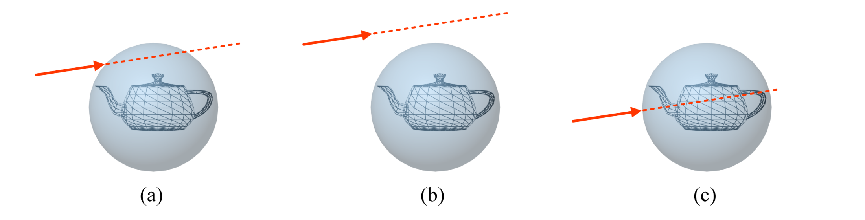
Ray-BV Intersection (cont’d)
Ray-sphere intersection test is often performed at the preprocessing step, and discards the polygon mesh that is guaranteed not to intersect the ray.
12-<number>

Slide 11
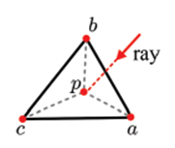

Ray-Triangle Intersection
When a triangle <a,b,c> is hit by a ray at p, the triangle is divided by p into three sub-triangles.
Let u denote the ratio of the area of <p,b,c> to that of <a,b,c>. It roughly describes how close p is to a. The closer, the larger. It can be taken as the weight of a on p.
When v and w are similarly defined, p is defined as a weighted sum of the vertices: p = ua + vb + wc.
The weights (u,v,w) are called the barycentric coordinates of p.
Obviously, u + v + w = 1, and therefore w can be replaced by (1-u-v), i.e., p = ua + vb + (1-u-v)c.
12-<number>

Slide 12
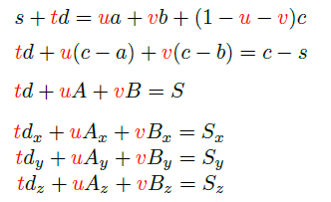
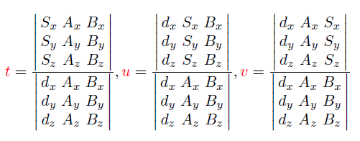

Ray-Triangle Intersection (cont’d)
Compute the intersection between a ray, s + td, and a triangle, <a, b, c>.
The solution to this linear system is obtained using Cramer's rule:
The intersection point can be obtained by inserting t into s + td or by inserting u and v into ua+vb+(1-u-v)c. However, note that we do not need the point itself.
More importantly, is p guaranteed to be inside the triangle?
12-<number>

Slide 13
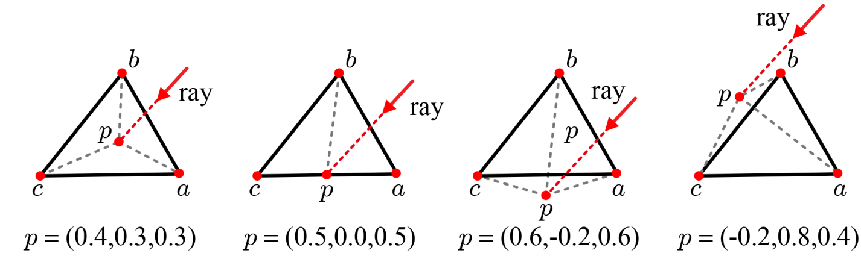

Ray-Triangle Intersection (cont’d)
In order for the intersection point to be confined to the triangle, the following condition should be satisfied: u ≥ 0, v ≥ 0, and u+v ≤ 1.
When every triangle of a mesh is tested for intersection with the ray, multiple intersections can be found. Then, choose the point with the smallest positive t.
12-<number>

Slide 14
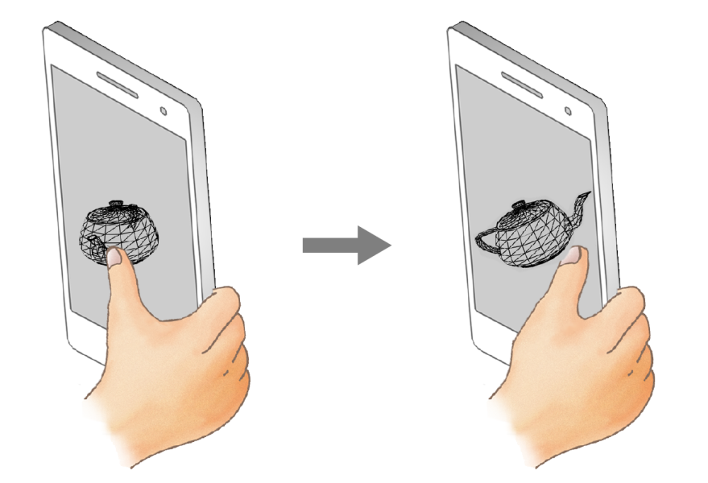
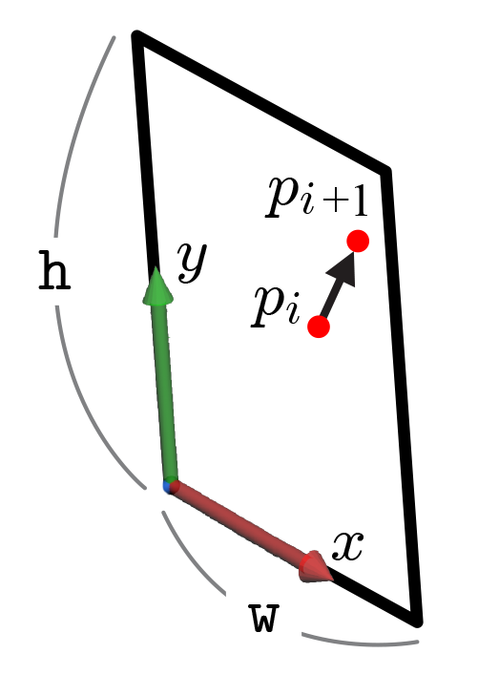
Rotating an Object
Rotating an object is used as frequently as picking an object.
On the 2D screen, the sliding finger's positions, {p₁, p₂, … , p_{n}}, are tracked. For each pair of successive finger positions, p_{i} and p_{i+1}, a 3D rotation is computed and applied to the object.
12-<number>

Slide 15
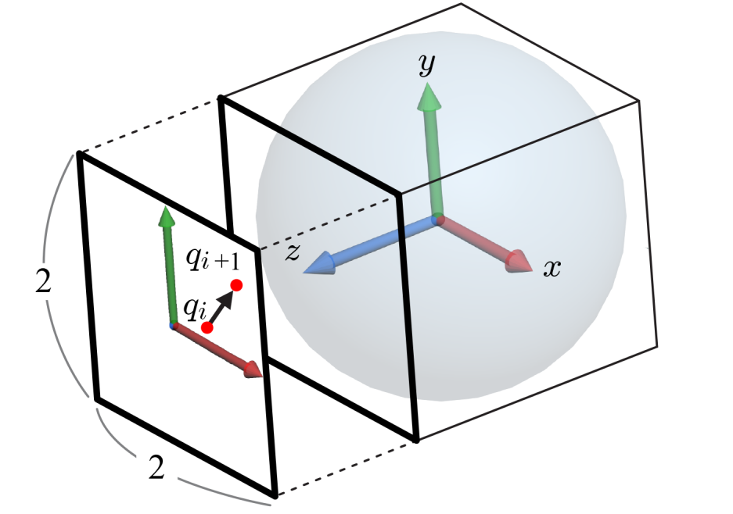

Arcball
The arcball is a virtual ball located behind the screen and encloses the object to rotate. The sliding finger rotates the arcball and the same rotation applies to the object.
For efficient implementation, the 2D screen with dimensions w×h is normalized to the 2×2 square, and the 2D coordinates, (x,y), of the finger's position are accordingly normalized, i.e., p_{i} and p_{i+1} are converted to q_{i} and q_{i+1}, respectively, in the square.
Note that the arcball is a unit sphere, the radius of which is one.
12-<number>

Slide 16


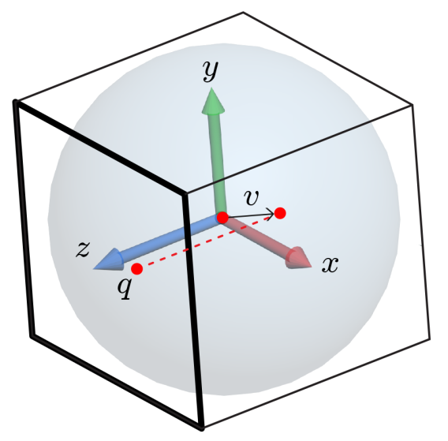
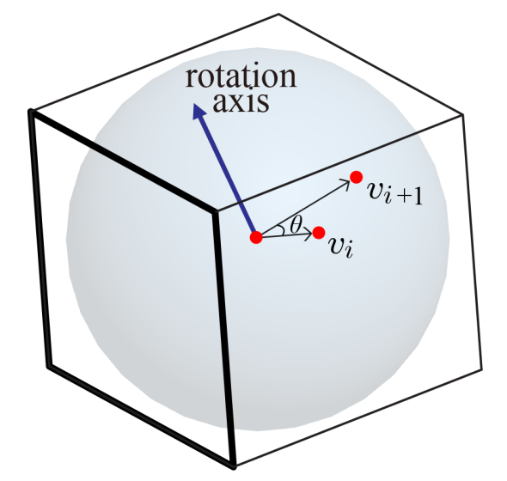
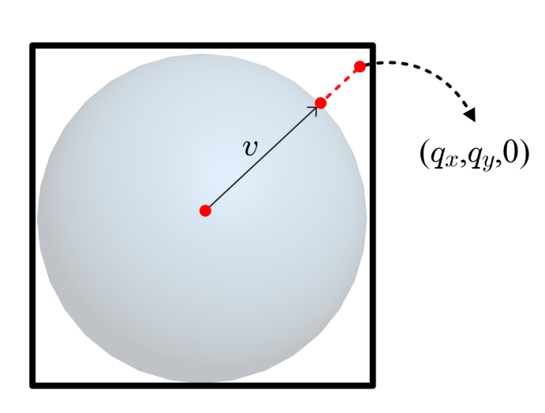
Arcball (cont’d)
Then, q is orthographically projected along –z onto the surface of the arcball. Let v denote the vector connecting the arcball’s center and the projected point.
Note that v_{x} = q_{x}, v_{y} = q_{y}, and .
If the projection is out of the arcball, i.e., if , v = normalize(q_{x},q_{y},0).
Given v_{i} and v_{i+1}, we can compute the rotation axis and angle.
  The rotation axis is obtained by taking the cross product of v_{i} and v_{i+1}.
  The rotation angle is obtained from the dot product of v_{i} and v_{i+1}.
12-<number>

Slide 17
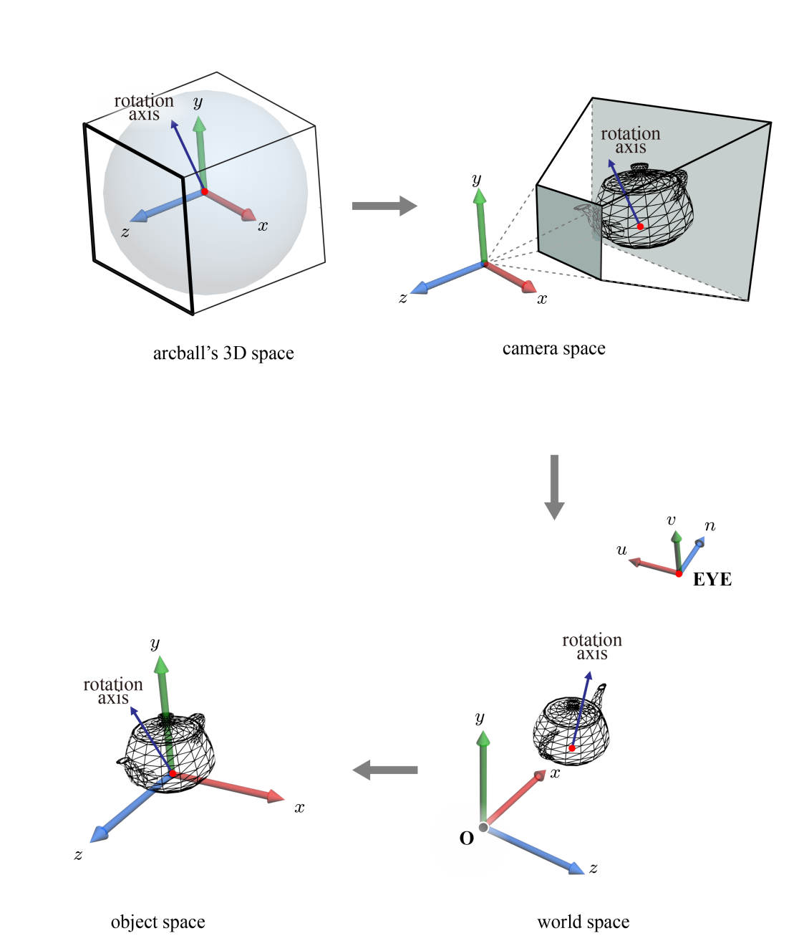
Object-space Rotation Axis
The rotation axis should be redefined in the object space so that the rotation is made prior to the original world transform.
We computed the rotation axis in the arcball's space. It is a temporarily devised coordinate system, which we have not encountered in the rendering pipeline.
Our strategy is then to take the rotation axis as is into the camera space of the rendering pipeline.
The rotation axis, as a vector, can be thought of as passing through the object in the camera space, and such a configuration is preserved in the object space.
12-<number>

Slide 18
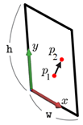
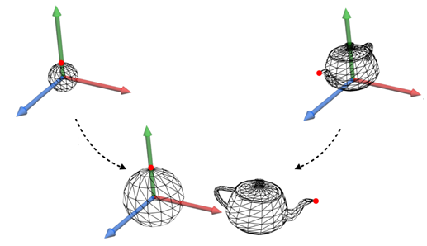


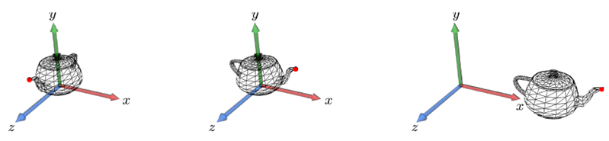
Rotating an Object - Implementation
We have defined the rotation axis and angle. Then, the rotation matrix can be obtained:
  Invoke glm::rotate(angle, axis).
  Define a quaternion and convert it into a matrix.
Let M denote the current world matrix. Initially, the finger is at p₁ on the screen. When the finger moves to p₂, the rotation axis is computed using p₁ and p₂. It is transformed from the world space back to the object space using the inverse of M.
Let R₁ denote the rotation matrix determined by the rotation axis. Then, MR₁ will be provided for the vertex shader as the world matrix, making the object slightly rotated in the screen.
M
M
12-<number>

Slide 19
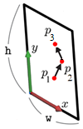
Rotating an Object – Implementation (cont’d)
Note that MR₁ presented in the previous page is the world matrix to define the screen when the finger is at p₂.
When the finger moves from p₂ to p₃, the rotation matrix is computed using the inverse of MR₁. Let R₂ denote the rotation matrix. Then, the world matrix is updated to MR₁R₂ and is passed to the vertex shader.
This process is repeated while the finger remains on the screen.
12-<number>

